Slide 1
TEE Liang Yuan
Mechanical Engineer
Data Science Student
IOD Cohort July 2021

Slide 2


Predict Holiday Package Sales
Prepared by TEE | 12th Jan 2022

Slide 3
Agenda
__________________
Project Background
__________________
Project Pipeline
__________________
Data Insight
__________________
Summary
__________________

Slide 4
Business Background
HIGHMarketing Cost
18%
Deal Closed
Last Year
New Marketing Campaign
1200 hours Spent on Sales Pitch Last Year
Purchased
852
Not Purchased
3645
Basic - 60%
Standard - 14%
Deluxe – 20%
Super Deluxe – 3%
King – 3%

Slide 5
Business Goal
Reduce Marketing Cost
Increase Sales
Stakeholder
Sales & Marketing Manager

Slide 6
Problem Overview
1. Which group of customers should be targeted to improve the market efficiency?
2. Will the sales increase if we engaged to the targeted customer group?

Slide 7
Data Pipeline
Collect Data
Data Cleaning
Data Analysis
Feature Engineering
Build ML Model
Data Presentation

Slide 8
Data Overview
Customer ID | Product Taken | Age | Type of Contact | City Tier | Duration of Pitch | Occupation | Gender | Number of Person Visiting
200000-204887 | 1, 0 | 18-61 | Self Enquiry, Company Invited | 1, 2, 3 | 5-127mins | Salaried, Free Lancer, Small Business, Large Business | Male, Female | 1-5
Num. of Follow ups | Product Pitched | Preferred Property Star | Marital Status | Number of Trips | Passport | Pitch Satisfaction Score | Own Car | Num. of Children Visiting | Designation | Monthly Income
1-6 | Basic Standard Deluxe Super Deluxe King | 3, 4, 5 | Single, Divorced, Married, Unmarried | 1-22 | 1, 0 | 1-5 | 1, 0 | 1-3 | Executive, Manager, Senior Manager, AVP, VP | 1000-98678
Data Shape: 4888 rows x 20 columns
Null value replaced by mean value (Max. null value per column = 251)
Data Source: https://www.kaggle.com/susant4learning/holiday-package-purchase-prediction

Slide 9
P1. Which group of customer should be targeted to improve the market efficiency?

Slide 10
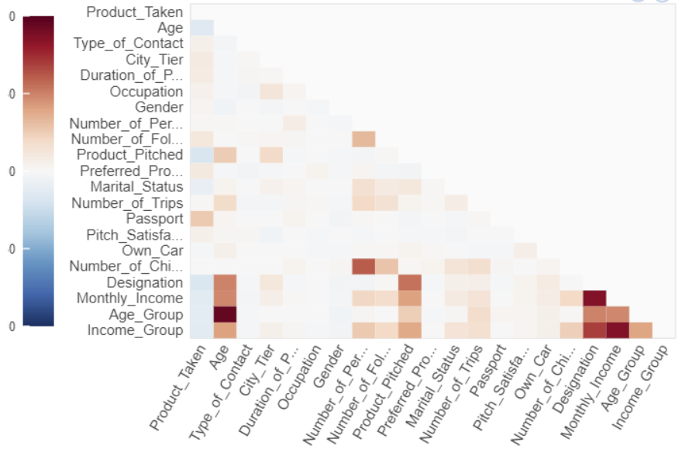
Correlation Chart

Slide 11
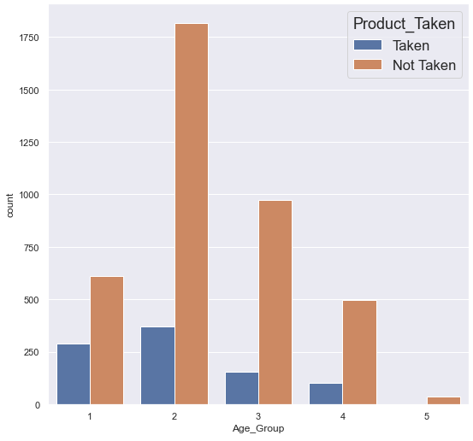
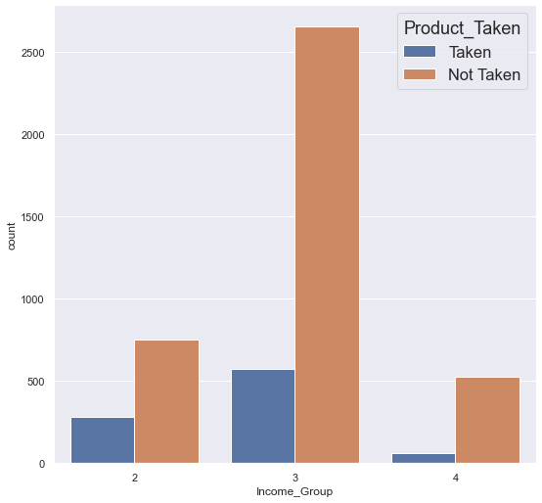
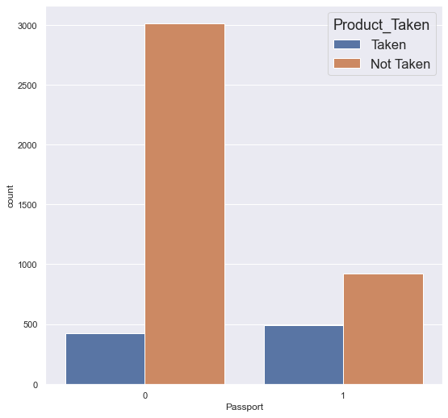
Age Group | Income Group | Passport
Age Group | Range | Product Taken
1 | Below 30 | 290
Income Group | Range | Product Taken
2 | 10k~20k | 283
Passport | Product Taken
1 | 492

Slide 12
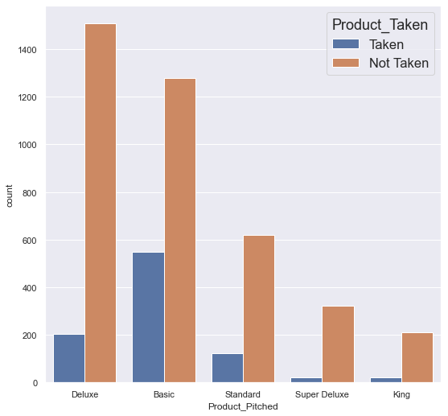
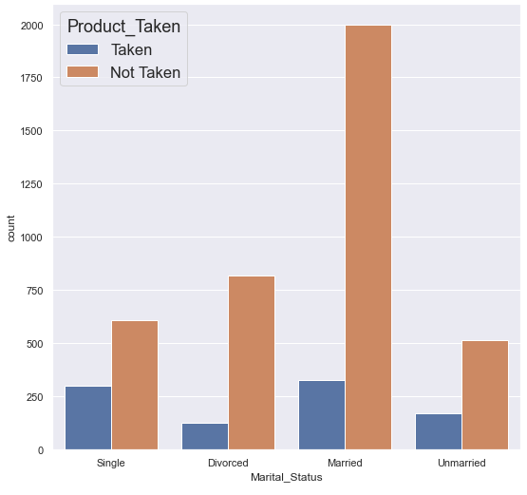
Product | N of Person Visit
Package | Product Taken
Basic | 547
Marital Status | Product Taken
Single | 300

Slide 13
Suggestion For P1
Columns | Group
Age Group | Below 30
Income Group | 10k ~ 20k
Passport | Passport Holder
Marital Status | Single
Package / Price | Basic / $

Slide 14
P2. Will the sales increase if we engaged to the target customer group?

Slide 15
Build ML Model
Perform A/B Testing

Slide 16
Feature Engineering
Age | Type of Contact | City Tier | Marital Status | Duration of Pitch | Gender | Number of Person Visit | Product Pitch | Passport
18-61 | Self Enquiry, Company Invited | 1, 2, 3 | Single, Divorced, Married, Unmarried | 5-127mins | 1, 0 | 1-5 | Basic Standard Deluxe Super Deluxe King | 1, 0
Self Enquiry : 0
Company Invited : 1
Basic : 0
Standard : 1
Deluxe : 2
Super Deluxe : 3
King : 4
Feature deducted from 21 to 11
Removed outlier
Convert all value to numeric value

Slide 17
Machine Learning Model
Model | Accuracy | Precision
K-NN | 0.925 | 0.847
Random Forest | 0.995 | 0.988
AdaBoost | 0.829 | 0.622
XGBoost | 0.961 | 0.990
LR | 0.826 | 0.665
Stacking | 0.995 | 0.991
Best Accuracy: 99.5%

Slide 18
A / B Testing
H0: Product taken does not increases for targeted customer.
H1: Product taken increases for targeted customer.
A | B
Below 30 | Random Selected
10k ~ 20k
$ Basic
Sample Size = 300
(t = 5.8 ) < (p = 9.2e-09)
Rejected null hypothesis.
Product taken increases for targeted customer.

Slide 19
Summary
Targeted Customer Group
ML Model
A/B Testing
Columns | Group
Age Group | Below 30
Income Group | 10k ~ 20k
Passport | Passport Holder
Marital Status | Single
Package | $ Basic
Model | Accuracy
Stacking | 99.5%
Product taken increases for targeted customer.

Slide 20
Future Improvement
1. Further development of ML Model for Sales Forecast
2. Collect more data like travel destination, travel date, and sales date for forecasting

Slide 21

Thank You!

Slide 22

Q & A

